Slide 1
Design and Implementation of a Manchester Encoding System
Project Presentation of Electronic Communication Sessional.

Slide 2
Team Members
Arpan Paul Sanju
Meherin Mashri Nijum
ID: 2102021
ID: 2102023
Abir Ahmed
Md. Anas Bin Hossain
ID: 2102024
ID: 2102029

Slide 3
What is Encoding?
The process of converting information from one form to another.
LINE CODING is a specific type of Encoding.
Converts binary data (0s and 1s) into electrical/optical signals.
Line coding is the process of converting digital data into digital signals for transmission.

Slide 4
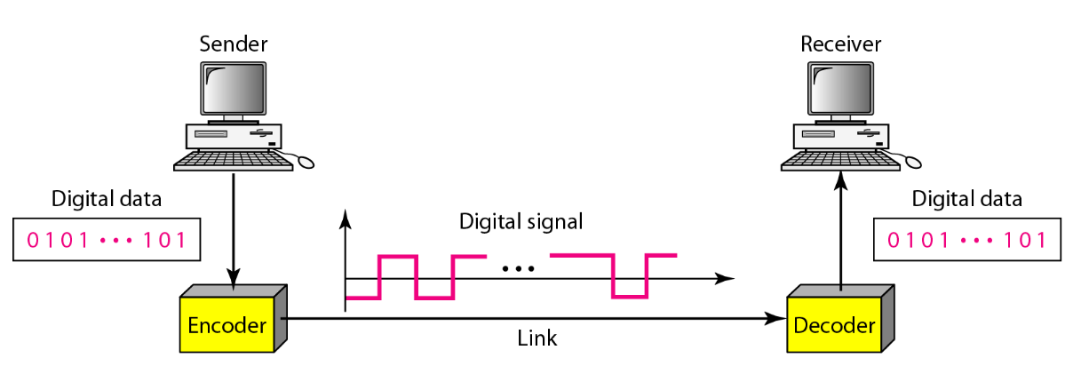
Line Coding in Communication

Slide 5
What is Manchester Encoding?
Definition: A synchronous clock-encoding technique that combines data and clock signals into one bitstream.
Self-Clocking: The clock signal is embedded in the data, eliminating need for separate clock line.
Transition-Based: Data is represented by transitions (high-to-low or low-to-high) at bit center.
IEEE 802.3 Standard: Logic 0 = high-to-low transition; Logic 1 = low-to-high.
G.E. Thomas Convention: Logic 0 = low-to-high; Logic 1 = high-to-low transition.

Slide 6
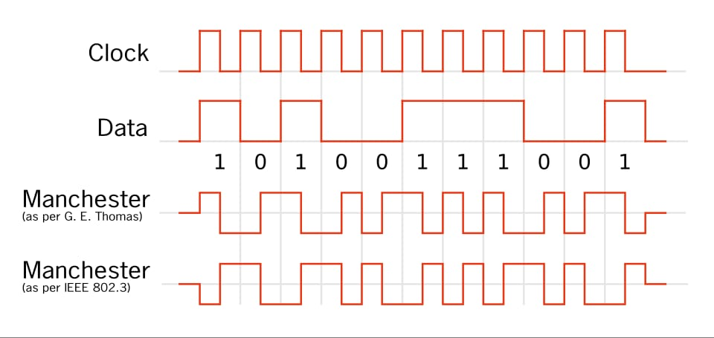
G.E. Thomas Convention & IEEE 802.3 Ethernet Standard

Slide 7
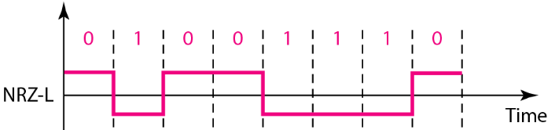
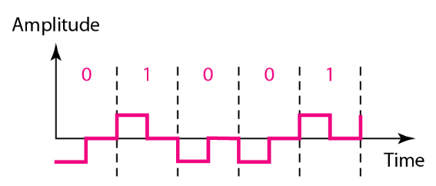
NRZ-L & RZ

Slide 8
The Optimal Hybrid Solution
Inherits Best of Both:
From NRZ-L: Only 2 voltage levels → Simple
Implementation From RZ: Guaranteed mid-bit transitions → Perfect clock synchronization
Eliminates Worst Problems:
NRZ-L's Flaw: No transitions during long runs → Clock sync lost
RZ's Flaw: 3 voltage levels needed → Complex, bandwidth-heavy

Slide 9
How Manchester Encoding Works
XOR Operation: Manchester = Data XOR Clock.
Guaranteed Transitions: At least one transition per bit period ensures clock recovery.
No DC Component: Signal does not stay at high or low for extended periods.
Better Synchronization: Receiver can extract timing information from transitions.

Slide 10
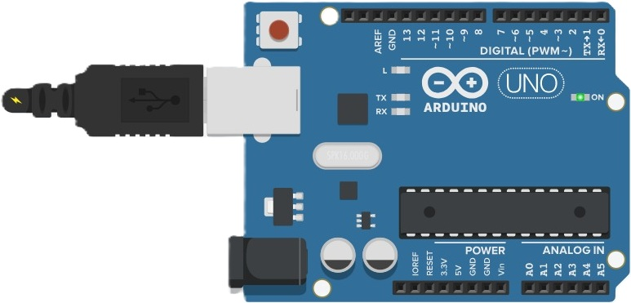
Arduino Implementation Setup
Microcontroller: Arduino UNO.
Serial Communication: 9600 baud.
Output: Serial Plotter visualization.
Clock Frequency: 1 Hz (1 second period).
Data Update Rate: Every 1 second.

Slide 11
Code Structure & Variables
// Timing parameters (OPTIMIZED FOR VISUALIZATION) const int CLOCK_HALF_PERIOD = 500; // 500ms = 1Hz clock const int DATA_DURATION = 1000; // Change data every 1 second unsigned long lastClockEdge = 0; unsigned long lastDataChange = 0;
int clockState = 0;
int dataBit = 0; (code structure variable)
Key Parameters: Clock toggles every 500ms, data changes every 1 second, enabling clear visualization on Serial Plotter

Slide 12
Arduino Loop Logic
// 1. Clock Generation (1Hz: 500ms high, 500ms low)
if (now - lastClockEdge >= CLOCK_HALF_PERIOD) {
clockState = !clockState;
lastClockEdge = now;
}
// 2. Data Generation (changes every 1 second)
if (now - lastDataChange >= DATA_DURATION) {
dataBit = !dataBit;
lastDataChange = now;
}
// 3. Manchester Encoding (XOR)
int manchester = dataBit ^ clockState; (Arduino loop logic)
Process: Clock and data are generated independently, then combined via XOR operation

Slide 13
Serial Data Output
// Send to Serial Plotter (with offsets for visualization)
Serial.print(dataBit); // Data (0 or 1)
Serial.print(" ");
Serial.print(clockState + 2); // Clock (2 or 3)
Serial.print(" ");
Serial.println(manchester + 4); // Manchester (4 or 5)
delay(100); // Update every 100ms (serial data output)
Output Format: Three traces visualized simultaneously with vertical offsets for clarity

Slide 14
Implementation Steps
Upload code to Arduino UNO via USB cable.
Open Tools → Serial Monitor (9600 baud rate).
Go to Tools → Serial Plotter to visualize signals.
Observe three traces: Data, Clock, and Manchester-encoded output.
Monitor timing of transitions at bit centers.
Verify XOR operation: output matches data ⊕ clock.

Slide 15

Mathematical Modeling
$$M\left(t\right)=D(t)⊕C(t)$$
Manchester encoding is modeled as an Exclusive-OR (XOR) operation. When Data is High (1), the output is the inverse of the Clock.

Slide 16
Mathematical Modeling
Input Data Bit | Clock Signal | Manchester Encoded Output
0 | 0 | 0
0 | 1 | 1
1 | 0 | 1
1 | 1 | 0

Slide 17
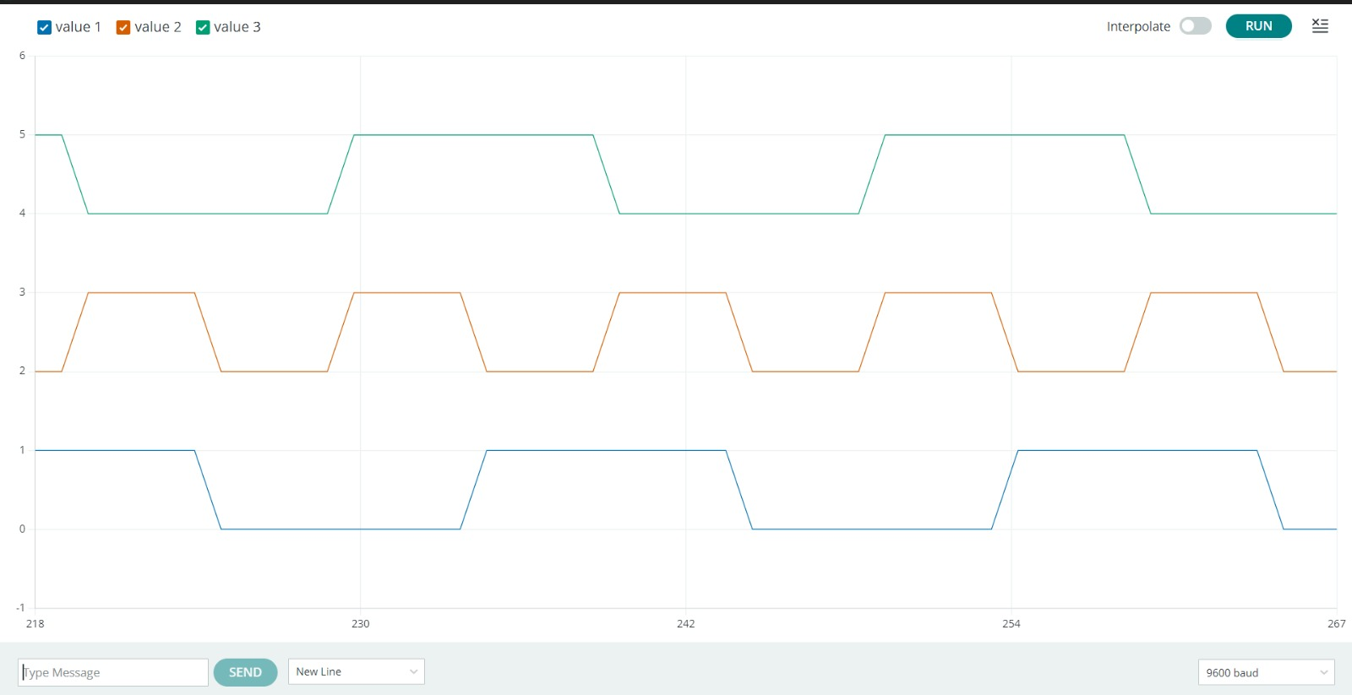
Serial Plotter Visualization
Blue: Data signal (0-1) | Orange: Clock signal (2-3) | Gray: Manchester output (4-5)

Slide 18
Encoding Example: Binary "1010"
Bit Value | Transition Type | Description
1 | High-to-Low ↓ | Transition downward at bit center
0 | Low-to-High ↑ | Transition upward at bit center
1 | High-to-Low ↓ | Transition downward at bit center
0 | Low-to-High ↑ | Transition upward at bit center

Slide 19
Key Concepts Summary
XOR Logic: Manchester = Data ⊕ Clock.
Self-Clocking: Receiver extracts clock from transitions.
Transition Density: High transitions ensure synchronization.
Biphase Code: Each bit encoded as 90° phase shift (positive or negative).

Slide 20
Key Takeaways
Manchester encoding combines clock and data signals using XOR operation providing self-clocking, error detection, and improved synchronization suitable for digital communication systems and embedded applications.
Arduino Serial Plotter effectively visualizes all three signals simultaneously.

Slide 21
Key Advantages
✓ Self-Clocking
✓ Error Detection
No separate clock signal needed, reduces wiring complexity.
Missing transitions indicate transmission errors.
✓ AC Coupling
✓ Reliability
No DC component allows galvanic isolation.
Better synchronization and noise immunity.

Slide 22
Limitations
Bandwidth Overhead: Requires twice the bandwidth of NRZ (Non-Return-to-Zero) encoding.
Lower Data Rate: Only half the data rate of unencoded signals at same frequency.
Power Consumption: Frequent transitions result in higher power consumption.
Distance Limitation: Not suitable for long-distance transmission due to signal attenuation.

Slide 23
Manchester Encoding
Why It's Reliable
Digital Communication Systems

Slide 24
Why Manchester Encoding is Reliable
Mid-bit Transitions: Let receiver recover clock and stay synchronized
Sharply Reduces Errors: Minimizes timing errors and bit slips
Fixed Pattern Detection: Transition pattern exposes errors immediately
DC-Balanced: Improves robustness over noisy AC-coupled channels
Real Applications: Used in Ethernet, RFID, and NFC systems

Slide 25
Summary
Manchester Encoding successfully combines data and clock into a single signal
Arduino implementation demonstrates XOR operation producing synchronized transitions
No separate clock infrastructure needed
Self-clocking property and error detection make it superior for synchronized data transfer
Limitations: 50% bandwidth efficiency loss, higher power consumption, sensitivity to channel noise

Slide 26
Real-World Applications
Ethernet
RFID/NFC
IR Protocols
10BASE-T and legacy Ethernet networks.
Radio frequency identification and near-field communication.
Infrared remote control systems.
Token Ring
Magnetic Storage
Space Systems
IEEE 802.5 network protocol.
Tape drives and magnetic drum storage.
Voyager spacecraft telemetry.

Slide 27
Thank You.

Slide 28
Questions?
Manchester Encoding System - Q&A Session

